Slide 1


Network Forensics Presentation SDAIA Network Forensics Analysis Report Dr. Abdullah Al.Boali June 2023
Student: Hamad Al.khalifah 219040274
Student: Yousef Alhassan 219012348

Slide 2


Introduction
SADAIA contributes to achieving the goals of Vision 2030 by offering a set of direct initiatives in the various vision programs, and it also works to empower various government agencies, by providing several services and products, such as: technical services, analytics, data-based scenarios, and artificial intelligence solutions for different use cases. data governance and artificial intelligence; In order to enable safe and orderly technical growth.

Slide 3




SDAIA APPLICATION
Tawakallna
Nafath
National Bank for Data
Deem Cloud

Slide 4
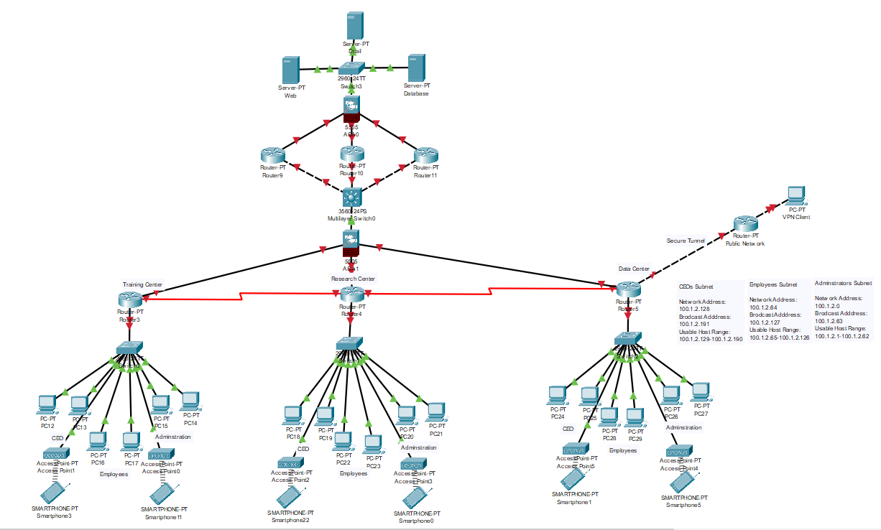
SDAIA Full Architecture

Slide 5
EVIDENCE
1- ARP Spoofing
2- DDOS Attack
3- Phishing Attack
4- Password Cracking Attack
5- WI-FI Hijacking
6- MAN-IN-THE-MIDDLE
7- Web server attack

Slide 6
Hacking Tools that are used
1- Operating System: Kali Linux
2- Arp Poisoning : Ettercap
3- DDOS: Hping3
4- Phishing Attack : SET (Social Engineering Toolkit)
5- Password Cracking : Hashcat

Slide 7
Phishing Attack Scenario
1- Target an authorized user inside SDAIA Org.
2- The attackers appears as a legitimate authorized user .
3- posses’ sensitive data and logs to the system.
4- the attackers set up a fake website that looks like a legitimate site.

Slide 8
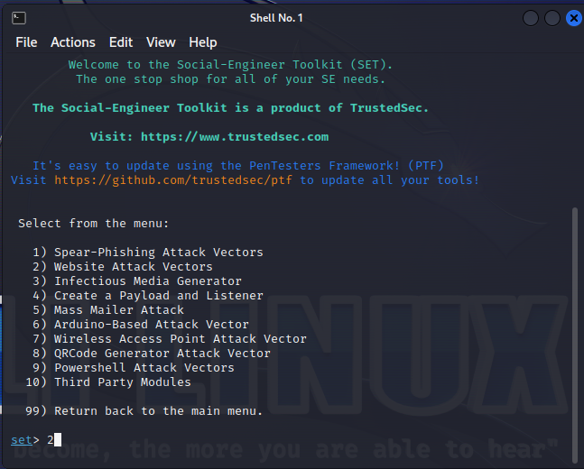
Phishing Attack Step 1

Slide 9
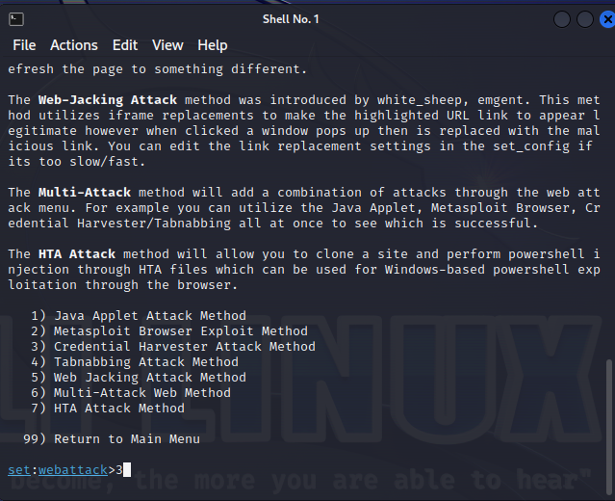
Phishing Attack Step 2

Slide 10
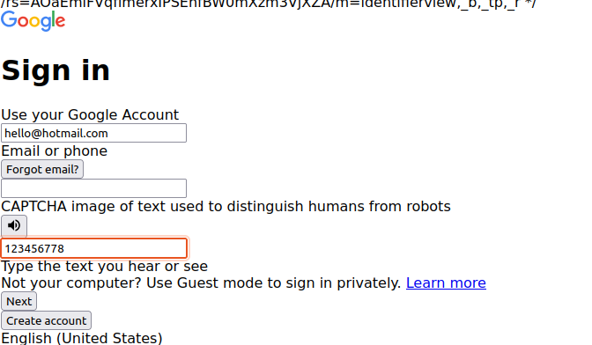
Phishing Attack Step 3

Slide 11
1). Scan the wireless network that are in range. 2). Identifying encryption type such as (MD4, MD5) to use dictionary attack. 3). Set up a fake wireless network that looks like SDAIA Internal network.
Wi-fi hacking Attack Scenario

Slide 12
1). the attackers target the weak password that doesn’t fulfills regulatory recommendations. 2). The attackers use dictionary attack in order not alert the server.
Password cracking Attack Scenario

Slide 13
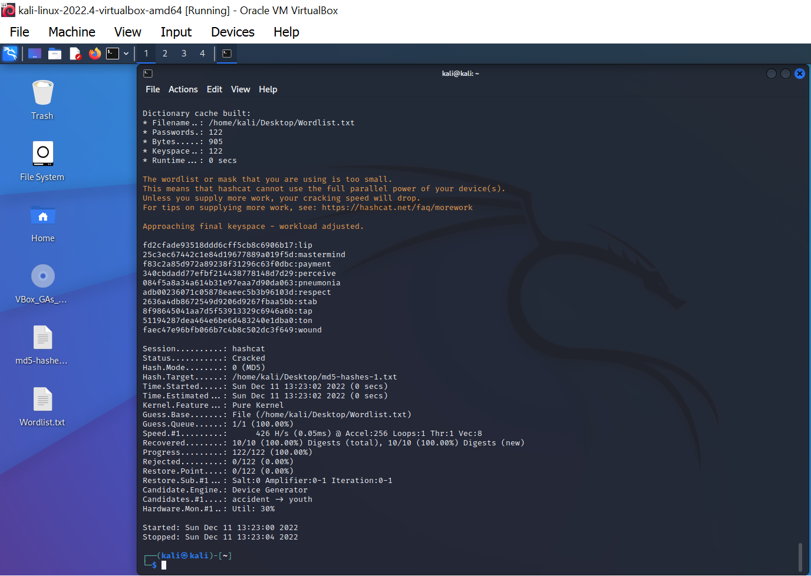
Password cracking Attack Steps

Slide 14
Man-in-the -middle -attack: Scenario
1- Attacker able to be inside the local network (LAN) then compromise the communication channel.
2-Intercept the communication between two parties
3-Various forms: (Email hijacking, DNS Spoofing, ARP Spoofing, Wi-fi hijacking, SSL/TLS hijacking, etc.,)

Slide 15
Web application Attack: Scenario
1-Inject malicious code (XSS) into a DOM (Document object Models) of SDAIA website.
2-The codes executed by one of the SDAIA employers.
3-injecting malicious (SQL commands) into web forms or URLs.
4- the attackers bypass authentication and access sensitive data to compromise the database

Slide 16
1). Scanning the IP addresses and mac addresses of the SDAIA network . 2). The attackers send a fake ARP message to the SDAIA computers . 3). the attackers were able to steal sensitive data that can be used to compromise the system. 4). intercept and modify and block network traffic that passes through attacker’s computers.
ARP Spoofing Scenario

Slide 17
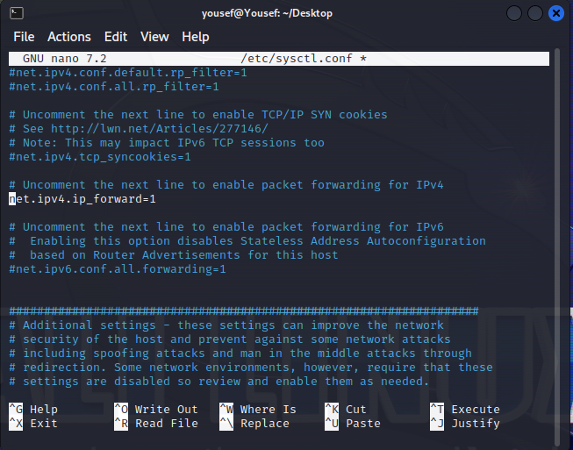
ARP Spoofing Step 1

Slide 18
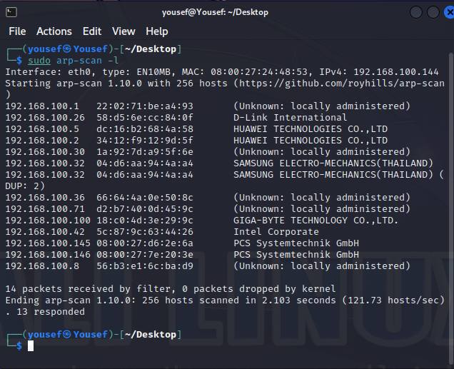
ARP Spoofing Step 2

Slide 19
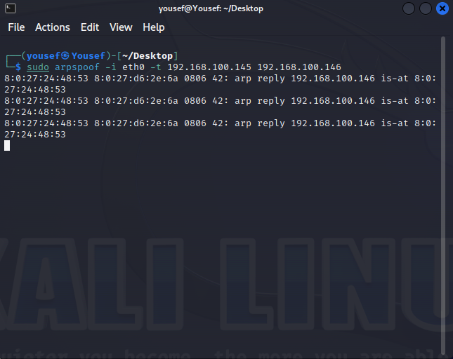
ARP Spoofing Step 3

Slide 20
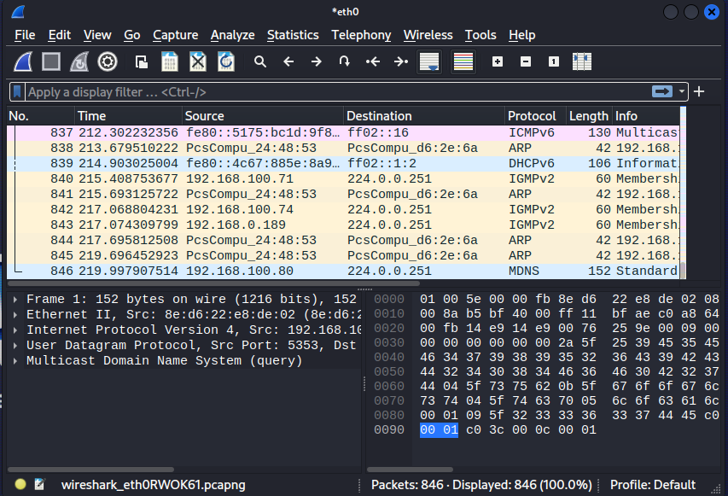
ARP Spoofing Step 4

Slide 21
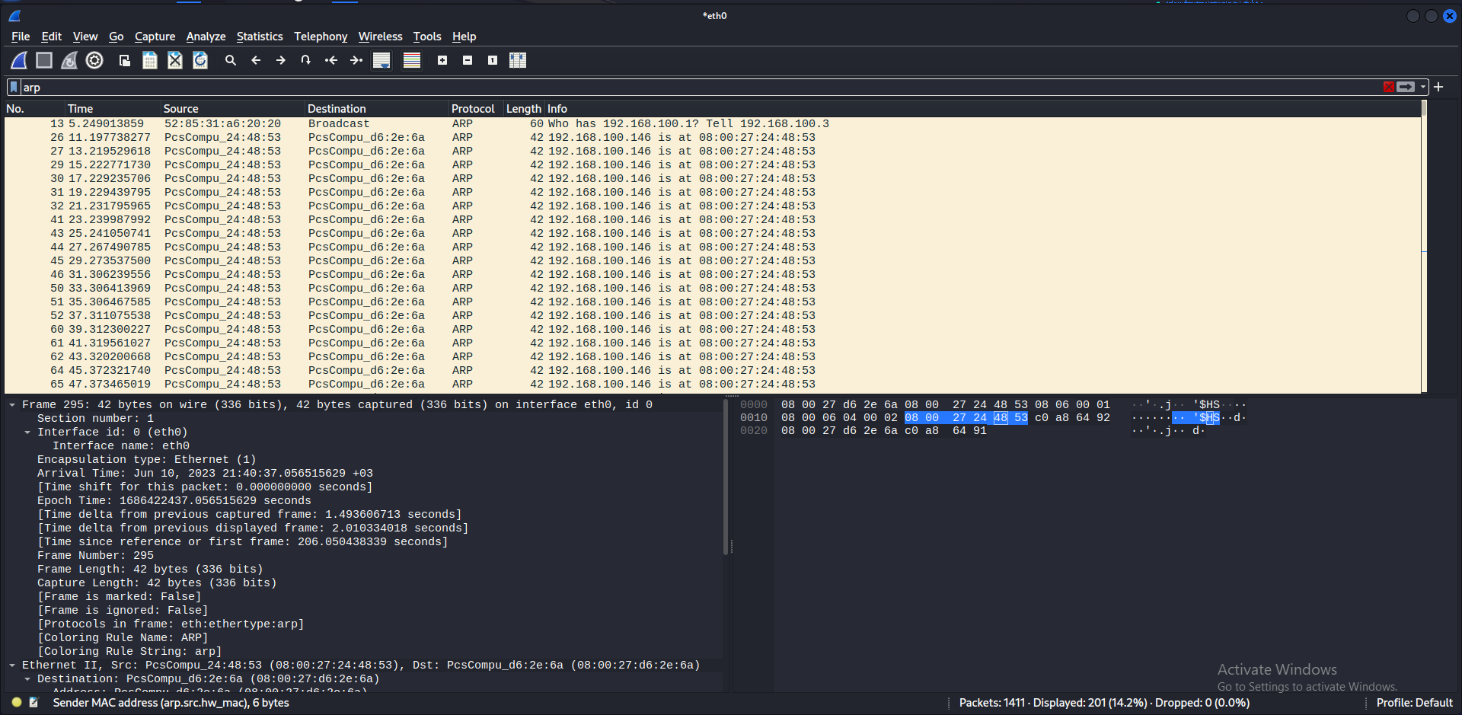
ARP Spoofing Step 5

Slide 22
DDoS Attack: Scenario
1- After compromising an authorized user in SDAIA system using fishing attacks.
2-Gain permissions to manipulate and control the system.
3-Create network of bots, known as a botnet, used to launch the attack.
4- Target the network to send a large amount of traffic to the target.

Slide 23
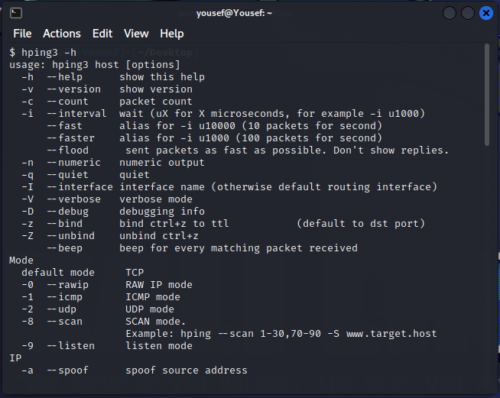
DDoS Attack Step 1 :

Slide 24
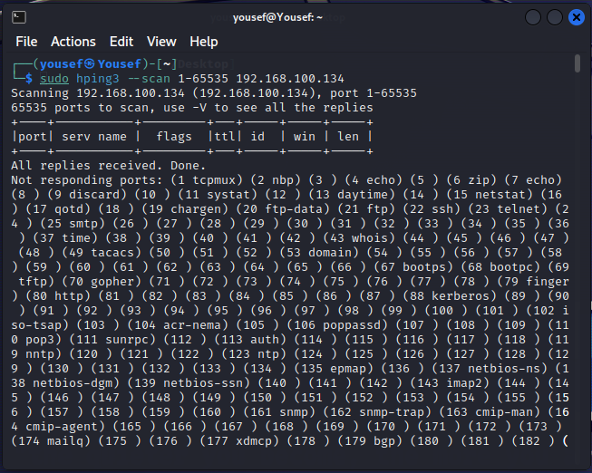
DDoS Attack Step 2 :

Slide 25
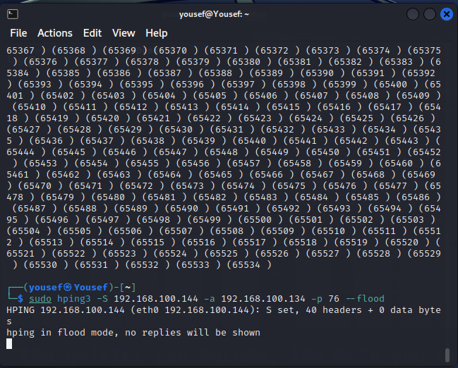
DDoS Attack Step 3 :

Slide 26
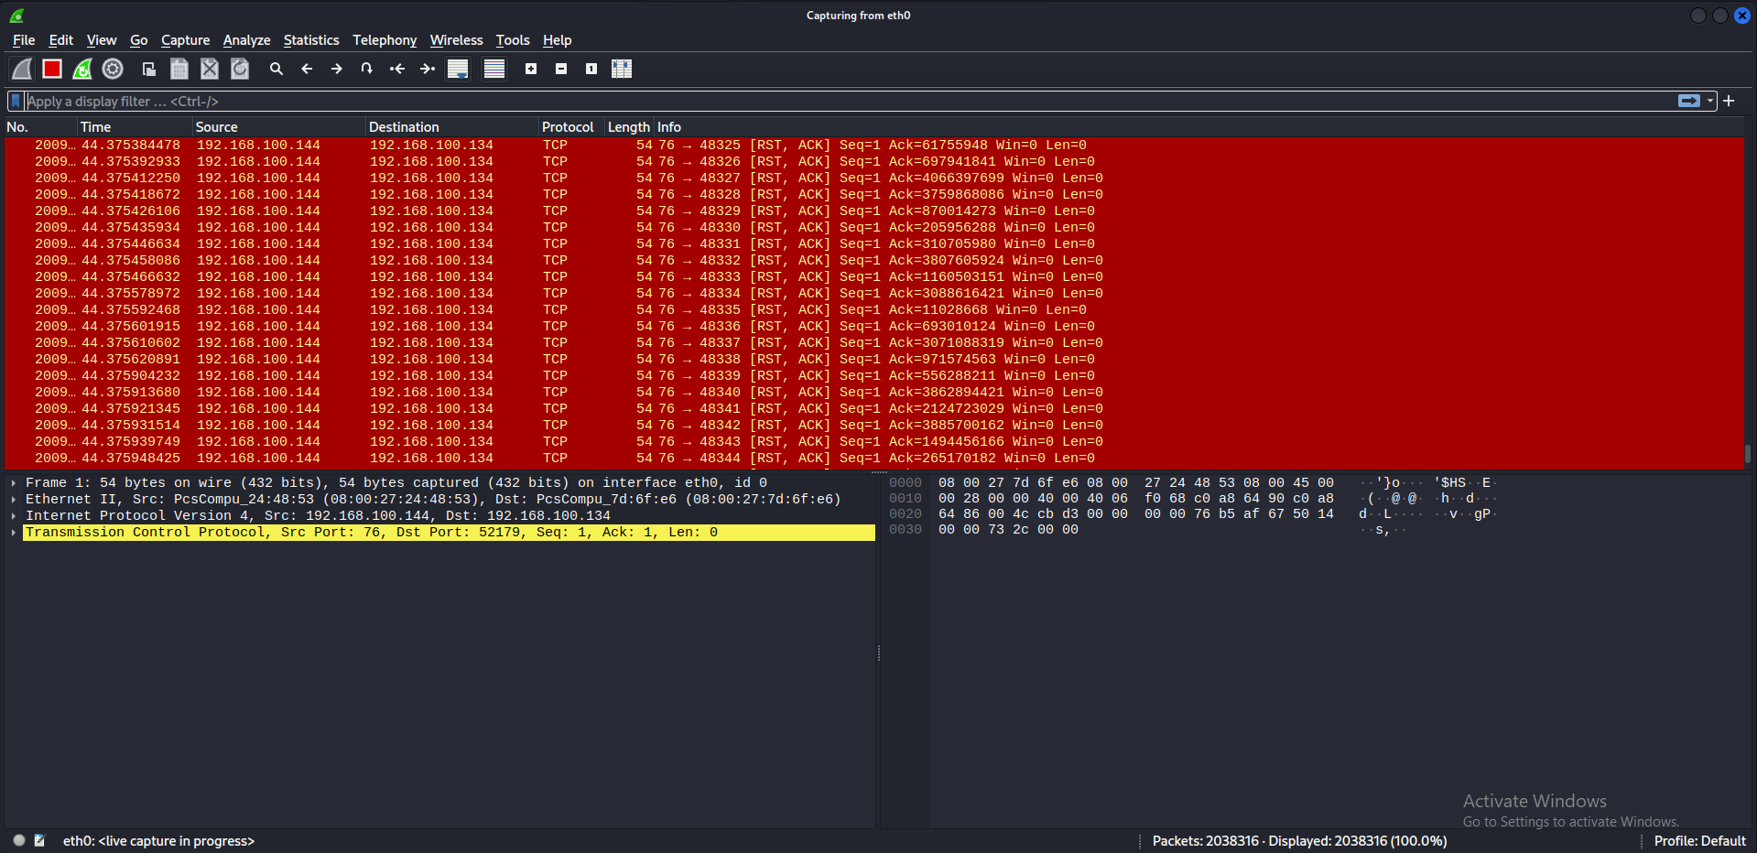
DDoS Attack Step 4 :

Slide 27
1- Valuable the damage of the attack? 2- How many services have been compromised? 3- Did the Attack contain and recovers? 4- How the attack happens external/internal? 5- Did the SDAIA Partners affected by this attack?
Objective 01

Slide 28
1- What is the valuable of data that lost? 2- Did the backup servers compromise? 3- Is ‘it confirmed that SDAIA network is free from any suspicious threats? 4- How long it takes to reconstruct the system into the backup servers?
Objective 02

Slide 29
1). Isolate the compromised system. 2). Preserve evidence by creating a forensic image of the system. 3). Identify the source and nature of the attack.
Forensic Analysis Mitigate the attack

Slide 30
1). create a cloud storage and store the data. 2). Store a backup servers at a safe offsite location . 3). ensure that the servers from multiple location is communicate together to store the system updates 4). Review and update security policies to prevent similar attacks in the future.
Forensic Analysis recover the system

Slide 31
Relevant Fields: Mitre.org
Attack | ID / Mitigation
DDoS | https://attack.mitre.org/mitigations/M1037
ARP Spoofing | https://attack.mitre.org/groups/G0003
Web Server | https://attack.mitre.org/groups/G0050
Man-in-the-middle | https://attack.mitre.org/groups/G0094
Password cracking | https://attack.mitre.org/software/S0056
Wi-Fi Attack | https://attack.mitre.org/mitigations/M0802

Slide 32
conclusion
It is important to understand the ways and approaches of network forensics and how to right an incidence response report to to discover evidence of attack . Also, how to mitigate an attack that compromise the system. Strategies in how restore a compromise system.

Slide 33
Thank you for listining

